Slide 1



ACCIDENT DETECTOR
PRESENTED BY
ANKITA MITTAL (081BCT017)
ARYA JHA (081BCT022)
ARBIND SHRESTHA (081BCT021)
JANAK BHATTA (081BCT036)
BIBASH KUMAR THAKUR (081BCT024)

Slide 2
BACKGROUND
Road accidents are a leading cause of injuries and fatalities globally, often resulting in critical delays due to manual reporting methods. Quick emergency response is essential to save lives, but reaching accident sites promptly remains a challenge.
This project focuses on developing an automated accident detection system using ESP combined with GSM and GPS technologies. The system detects sudden impacts through sensors, captures the exact location using GPS, and instantly sends alert messages via GSM to emergency contacts, thereby significantly reducing response time and enhancing road safety.

Slide 3

PROJECT GOALS
To develop a portable, low-cost accident detection system.
To detect accidents through abrupt motion or shock.
To retrieve GPS location upon detection.
To notify emergency contacts via SMS with location details.

Slide 4
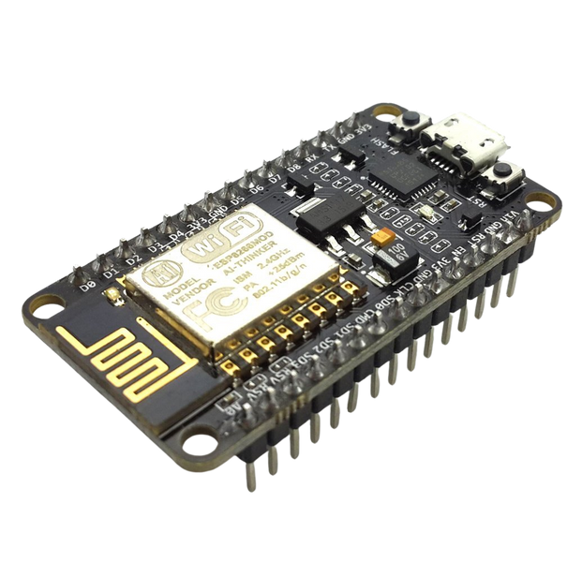
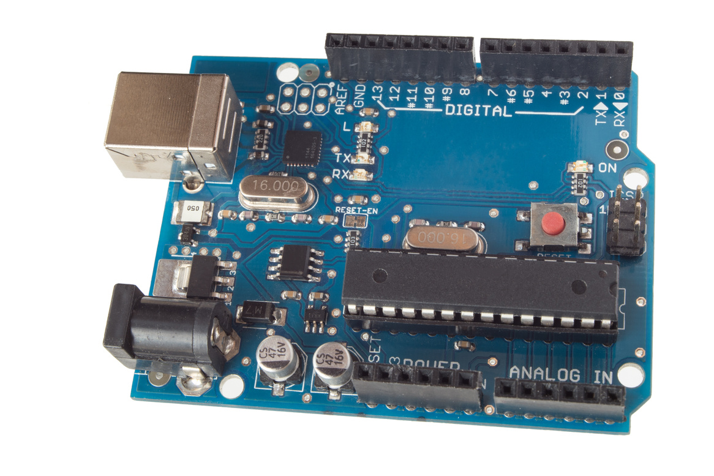
COMPONENTS USED
MICROCONTROLLER (ESP8266)
FOR ACCIDENT DETECTION SYSTEMS, WE CAN USE VARIOUS MICROCONTROLLERS LIKE:
🔹 Arduino UNO / Nano
🔹 ESP8266 (also known as NodeMCU)
🔹 ESP32, etc.
Arduino Uno
ESP8266

Slide 5
COMPONENTS USED
MICROCONTROLLER (ESP8266)
In our project, we used ESP8266 (NodeMCU) instead of Arduino because:
✅ It has built-in Wi-Fi, which allows us to send accident alerts online.
✅ Reduces the need for an external Wi-Fi module like ESP-01.
Limitations:
However, ESP8266 has limited GPIO pins, so if your project includes multiple sensors or input devices, it’s better to use Arduino as the main controller and ESP8266 just for Wi-Fi communication.

Slide 6
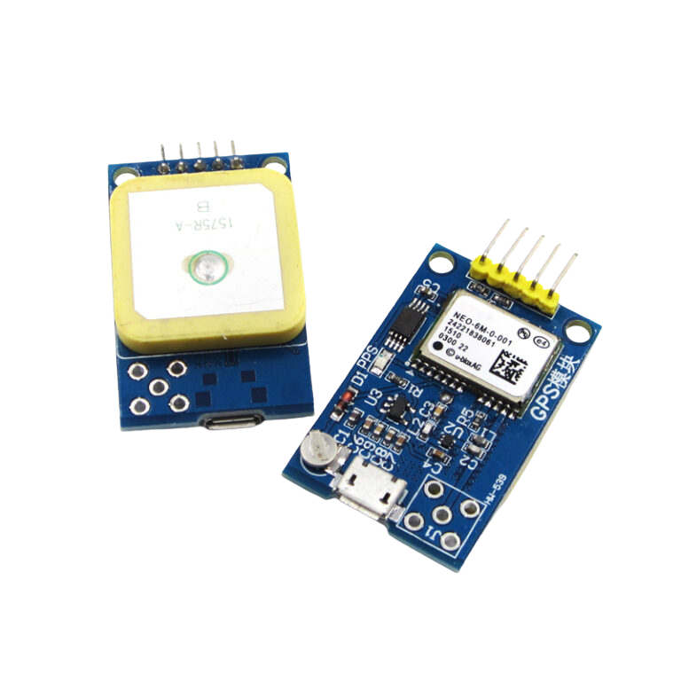
COMPONENTS USED
GPS6MV2 MODULE: RETRIEVES REAL-TIME LOCATION.
GPS6MV2 IS A (GLOBAL POSITIONING SYSTEM) RECEIVER MODULE USED TO OBTAIN THE EXACT LATITUDE, LONGITUDE, SPEED, AND TIME OF A VEHICLE.
IT HELPS TO PINPOINT THE ACCIDENT LOCATION SO THAT EMERGENCY MESSAGES CAN BE SENT ALONG WITH ACCURATE COORDINATES.

Slide 7
COMPONENTS USED
GPS MODULE: RETRIEVES REAL-TIME LOCATION.
Features:
Operates on 3.3V–5V, making it compatible with Arduino and ESP8266
UART interface (TX, RX) for easy serial communication
High sensitivity: works well in moving vehicles
Limitations:
Does not catch signal indoors (requires open sky)
Accuracy reduces in tunnels, forests, or between tall buildings
Takes time (cold start) to lock satellites initially
Heavily depends on satellite availability

Slide 8
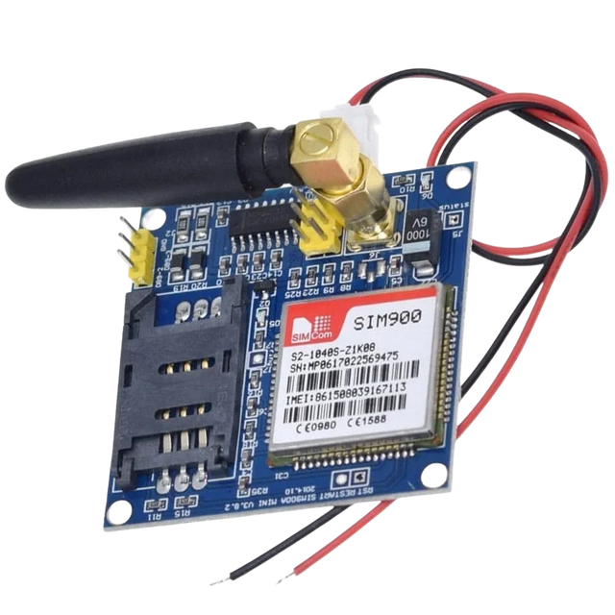
COMPONENTS USED
GSM MODULE (SIM900A): SENDS SMS ALERT.
(OPTIONAL)
The SIM900A is a GSM (Global System for Mobile Communication) module used to send:
📱 SMS alerts
📞 Make/receive calls
It works just like a mobile phone:
Insert a SIM card
Connect to a mobile network
Send/receive messages or calls using AT commands

Slide 9
COMPONENTS USED
GSM MODULE (SIM900A): SENDS SMS ALERT.
(OPTIONAL)
Why Use SIM900A in Accident Detection Projects?
Helps send an SMS alert to family or emergency services with accident info.
Works independently of Wi-Fi, so it’s great for remote areas without internet.
Limitations
Slower than Wi-Fi-based modules like ESP8266
Requires a valid SIM card with balance/network
Needs a stable 2A power supply to avoid restart issues
Supplying more than 5V may damage the module

Slide 10
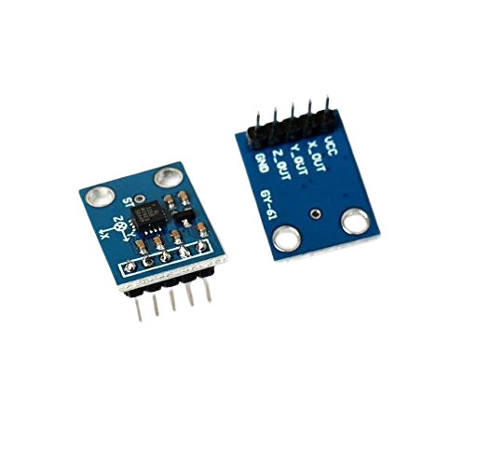
COMPONENTS USED
ADXL335 ACCELEROMETER: DETECTS SUDDEN ACCELERATION (SHOCK) TO IDENTIFY ACCIDENTS
Detects sudden acceleration, deceleration, or shock.
Identify accidents by monitoring unusual vehicle motion.
3-axis accelerometer (X, Y, Z).
Measures acceleration in the range of ±3g i.e. –29.4 m/s² up to +29.4 m/s².
Analog output signals for each axis.
Low power consumption (typically 3.3V), suitable for embedded systems.
High sensitivity and accuracy.

Slide 11
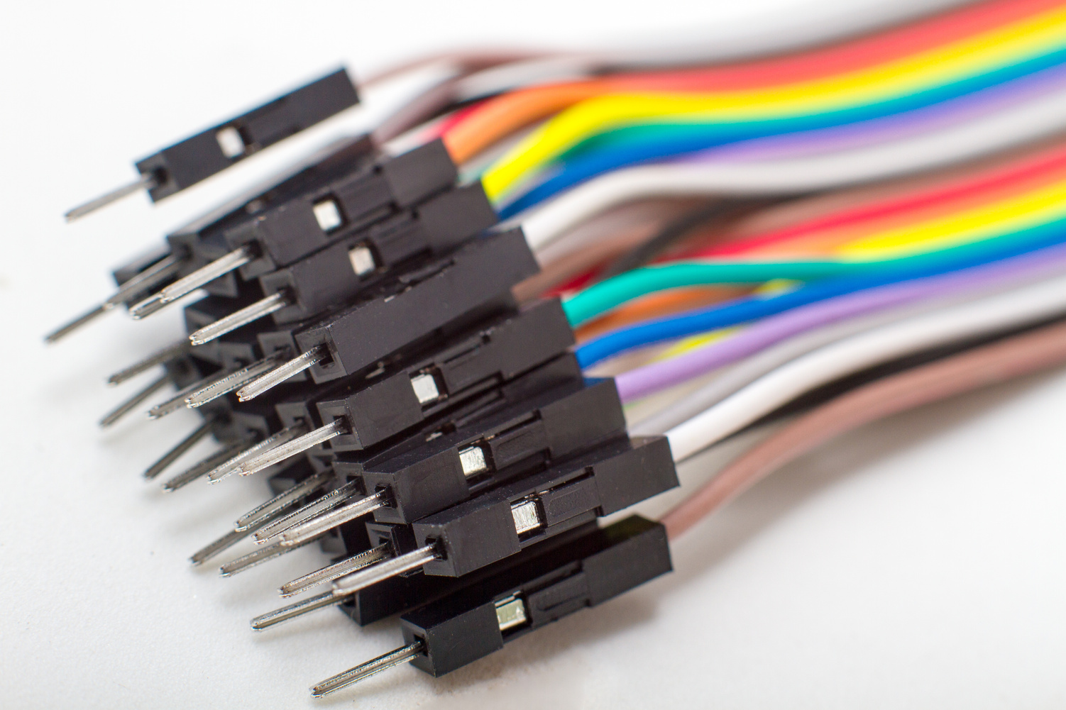
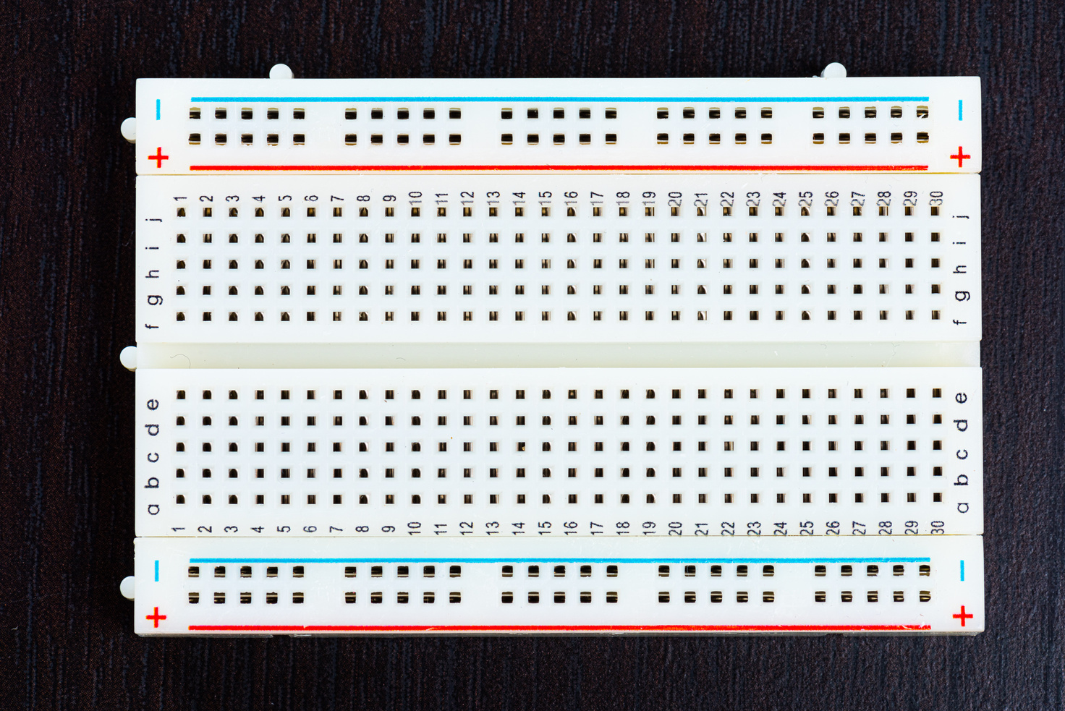
COMPONENTS USED
BREADBOARD AND JUMPER WIRES: FOR PROTOTYPING CONNECTIONS.

Slide 12

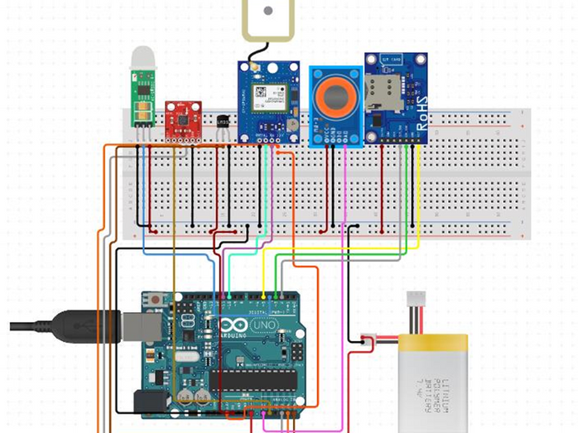
METHODOLOGY
CONTINUOUS MONITORING
The ADXL335 accelerometer continuously measures acceleration on X, Y, and Z axes.
Arduino/ESP reads these values to detect motion or sudden shocks.

Slide 13
METHODOLOGY
SHOCK DETECTION
Arduino/ESP calculates changes in acceleration values.
If the change exceeds a set threshold (indicating a crash or collision), it assumes an accident has occurred.

Slide 14
METHODOLOGY
LOCATION RETREIVAL
Arduino/ESP requests GPS coordinates from the GPS module.
The GPS module returns current latitude and longitude.

Slide 15
METHODOLOGY
SMS ALERT GENERATION/MAIL ALERT
Arduino prepares an emergency SMS containing the accident alert and GPS location.
The message is sent via the SIM900A GSM module to a predefined contact number.
If ESP is used then the same alert can be sent via mail.

Slide 16
APPLICATIONS
Vehicle tracking and crash alert
Elderly driver safety
School/college bus monitoring
Taxi and delivery fleets

Slide 17
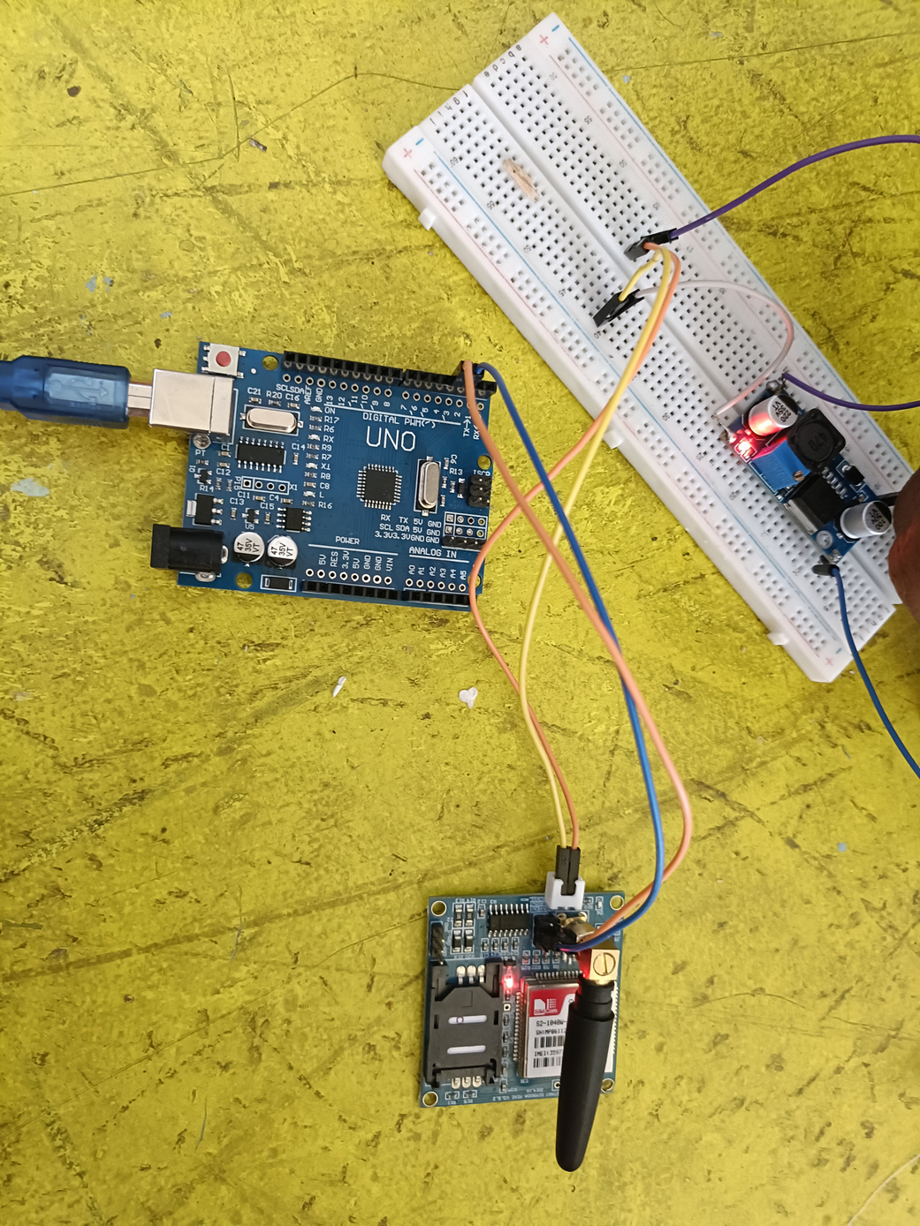
LIMITATIONS
FALSE POSITIVES ON SPEED BUMPS
GPS INACCURACY IN TUNNELS OR INDOORS
GSM NETWORK DEPENDENCY AND AVAILABILITY OF INTERNET

Slide 18
FUTURE ENHANCEMENT
IOT-based cloud alert system
Emergency call instead of SMS
Voice feedback or SOS button

Slide 19

CODE INSTALLATION
Arduino IDE Integration
The Arduino IDE (Integrated Development Environment) is a software platform used to write, compile, and upload code to Arduino boards. It supports C/C++ programming and provides a simple interface with features like syntax highlighting, code verification, and serial monitor for debugging. The IDE comes with built-in libraries and examples, making it beginner-friendly for creating electronic projects and controlling hardware components. It runs on Windows, macOS, and Linux.

Slide 20
CODE INSTALLATION
HEADER FILES AND LIBRARY
Header files (.h files) or libraries are collections of pre-written code that add extra functionality to your program.
They contain functions, classes, and definitions to do specific tasks (like handling WiFi, GPS, email, etc.).
You include them at the top of your code with ‘#’ symbol like (#include).

Slide 21
CODE INSTALLATION
ESP8266wifi.h
This is a library specially made for the ESP8266 WiFi module.
It gives your microcontroller the ability to connect to WiFi networks, manage connections, and communicate over the Internet.

Slide 22
CODE INSTALLATION
FUNCTION
PURPOSE
WiFi.begin(ssid, password);
Connects the ESP8266 to a WiFi network using the given SSID and password.
WiFi.status();
Returns the current connection status (e.g., connected,disconnected).
WiFi.localIP();
Returns the local IP address assigned to the ESP8266 by the router.
WiFi.disconnect();
Disconnects the ESP8266 from the WiFi network.
WiFi.SSID();
Returns the SSID of the currently connected network.
WiFi.macAddress();
Returns the unique MAC address of the ESP8266.

Slide 23
CODE INSTALLATION
ESP_Mail_Client.h
This library allows the ESP8266 (and ESP32) to send and receive emails over the Internet using the SMTP and IMAP protocols.
It handles all the complex parts of email communication (authentication,encryption, server connection), making it easy to add email alerts to IoT projects.

Slide 24
CODE INSTALLATION
FUNCTION
PURPOSE
ESP_Mail_Session
Creates a session object to configure the email server (host,port, login info).
SMTP_Message
Creates an email message object (subject, sender, recipient,body, attachments).
smtp.connect()
Connects to the SMTP server using the session info.
MailClient.sendMail()
Sends the email message to the server.
smtp.isAuthenticated()
Checks if login to the mail server was successful.

Slide 25
CODE INSTALLATION
TinyGPS++.h
TinyGPS++ is a lightweight and powerful C++ library used with Arduino and ESP boards to parse and process GPS data from GPS modules.
It extracts meaningful information like:
Latitude & longitude
Speed
Date & time
Number of satellites, etc.

Slide 26
CODE INSTALLATION
FUNCTION
PURPOSE
gps.encode(char)
Feeds raw NMEA data (from GPS module) into the parser.
gps.location.isUpdated()
Checks if a new location fix is available.
gps.location.lat()
Gets the current latitude.
gps.location.lng()
Gets the current longitude.
gps.satellites.value()
Returns the number of satellites currently in view.
gps.speed.kmph()
Returns speed in km/h.

Slide 27
CODE INSTALLATION
SoftwareSerial.h
SoftwareSerial is an Arduino library that allows your board to create additional serial communication ports (TX/RX) using normal digital pins.
This is useful when your board has only one hardware serial port (like ESP8266) but you need to connect multiple serial devices (e.g., GPS, GSM module).

Slide 28
CODE INSTALLATION
FUNCTION
PURPOSE
SoftwareSerial(rxPin, txPin);
Creates a new software serial port on the specified RX and TX pins.
.begin(baudRate);
Starts serial communication at the specified speed (e.g.,9600 bps (bit per second)).
.available();
Checks if there is data available to read.
.read();
Reads one byte from the serial buffer.
.write() / .print()
Sends data out through the serial port.

Slide 29
CODE INSTALLATION
Google App Password
A Google App Password is a special 16-character passcode generated by Google.
It allows apps and devices (like your ESP8266, Arduino, or old email clients) to access your Google account securely, without using your main Gmail password.
Example :- abcd efgh ijkl mnop

Slide 30
CODE INSTALLATION
SMTP
SMTP (Simple Mail Transfer Protocol) is the standard protocol to send emails.
smtp.gmail.com is Google’s SMTP server.
Port 465 is used for SSL/TLS secure connections (recommended).
Total port numbers available : 65536 ports

Slide 31
CODE INSTALLATION
How Accelerometer detect accident ?
The accelerometer continuously measures the force or acceleration in three directions: X, Y, and Z axes.
Your program keeps comparing the current sensor readings with the
previous values.
If the difference between them suddenly becomes very large (above a certain threshold, e.g., > 50)
Code Example :-
if (abs(xValue - prevX) > 50 || abs(yValue - prevY) > 50 || abs(zValue - prevZ) > 50)

Slide 32
FUTURE ENHANCEMENT
Software Development Mobile App
User authentication (Firebase/Auth0)
Real-time accident alerts via push notifications
GPS location tracking and history
SOS emergency contact integration

Slide 33
FUTURE ENHANCEMENT
Web Development
Admin dashboard for monitoring accidents
User profile management
Analytics and reports on accident occurrences
IoT Data Handling: Use MQTT or WebSockets for real-time data transmission from ESP8266
MQTT stands for Message Queuing Telemetry Transport
It is a lightweight messaging protocol designed for devices with limited resources (like sensors, IoT devices, microcontrollers) and networks with low bandwidth or high latency.

Slide 34
CONCLUSION
In conclusion, the Accident Detection System using Arduino presents an efficient, low-cost, and real-time solution to address the growing concern of delayed emergency responses in road accidents. By utilizing sensors like the ADXL335 for impact detection and GPS and GSM modules for location tracking and alert communication, the system ensures that immediate notifications are sent during critical moments. This automated approach not only reduces human dependency but also improves the chances of timely medical assistance, potentially saving lives. The project demonstrates how embedded systems and IOT components can be integrated to build practical safety applications in the real world.

Slide 35
THANK YOU

